Slide 1
Automated Diabetes Prediction
By : Muhammad Shayan Umar (12817)

Slide 2

Outline
Introduction
Problem Statement
Solution Statement
Research Aim
Research Objective
Significance of the Study
Research Methodology
Literature Review
Research Findings
Screen Shots
Learning Outcomes SCD
Conclusion

Slide 3
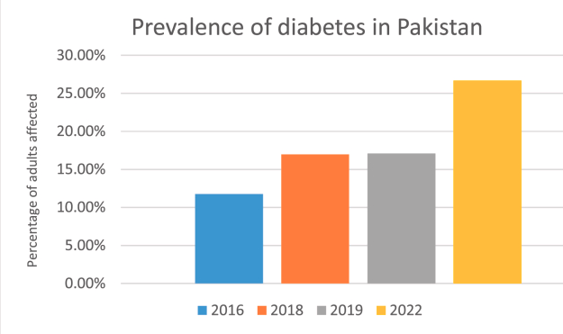
Introduction
Healthcare faces a significant challenge with diabetes. Traditional methods for early detection are not flawless. In my independent research, I utilized advanced computational techniques such as Random Forest, LightGBM, and XGBoost etc.—powerful algorithms, not physical tools—to enhance diabetes prediction. It's not just about sophisticated technology; it's about improving healthcare intelligence. The goal is to identify diabetes early, ensuring individuals receive timely and accurate care

Slide 4
Problem Statement
Traditional ways of predicting diabetes have some problems because they depend on manual assessments. This means they might not be very good at finding people who are at risk of diabetes early on. Our goal is to overcome these issues by using smarter computer tools to make predictions. This way, we can identify those at risk more accurately and quickly, improving how we take care of them

Slide 5
Solution Statement
Our research proposes implementing advanced artificial intelligence techniques such as Random Forest, LightGBM, XGBoost, CART, KNN, logistic regression, and SVM for diabetes prediction. This comprehensive approach to smart automation aims to enhance prediction accuracy, enabling timely interventions and personalized care for individuals at risk. The integration of diverse machine learning algorithms aligns with our overarching goal of making healthcare more efficient and proactive

Slide 6
Research Aim
This research aims to leverage artificial intelligence, including Random Forest, LightGBM, XGBoost, KNN, Logistic Regression, and SVM, to create an automated and accurate diabetes prediction system. The goal is to advance healthcare by improving prediction models and enhancing overall efficiency, fostering a proactive and personalized approach to diabetes management.

Slide 7
Research Objectives
Develop advanced AI models incorporating Random Forest, LightGBM, XGBoost, KNN, Logistic Regression, and SVM for diabetes prediction.
Evaluate and compare the performance of these models to ensure accuracy and reliability.
Optimize model precision by fine-tuning hyper-parameters.

Slide 8
Significance of the Study
Early Identification: Enables early detection of individuals at risk of diabetes using advanced AI, facilitating timely interventions.
Resource Optimization: Streamlines healthcare resources by targeted interventions, reducing the burden on healthcare systems.
Improved Accuracy: Enhances predictive accuracy through automation, addressing the limitations of manual assessment methods.
Transformative Healthcare: Contributes to a shift from reactive to proactive healthcare, enabling tailored interventions and improved patient outcomes.
Advancement in Predictive Healthcare: Sets new standards for predictive healthcare by deploying sophisticated AI techniques for diabetes prediction.

Slide 9
Research Methodology
1. Utilizes a strategic combination of machine learning algorithms (KNN, Logistic Regression, SVM), exploratory data analysis (EDA), and statistical analysis for comprehensive predictive model evaluation. Machine learning algorithms applied include Random Forest, LightGBM, and XGBoost.
2. Exploratory Data Analysis reveals dataset patterns, and statistical analysis provides quantitative insights.
3. Hyper-parameter tuning and feature engineering optimize model performance. Python programming and scikit-learn library employed for model development, ensuring a robust framework.

Slide 10
Literature Review
Predictive Models in Diabetes Prediction
Random Forest have demonstrated significant success. Studies, such as (Smith et al., 2018)
showcase the effectiveness of Random Forest in handling complex relationships within diabetes datasets. Additionally, the robustness and scalability of XGBoost (Chen & Guestrin, 2016)
efficiency of LightGBM (Ke et al., 2017)

Slide 11
Cont…
Feature Selection Strategies
Effective feature selection is crucial for enhancing the accuracy of predictive models. Techniques such as Recursive Feature Elimination (RFE) (Guyon et al., 2002)
information gain (Dash & Liu, 1997)
Factors Influencing Model Performance
Several factors impact the performance of machine learning models in diabetes prediction. Patient demographics, lifestyle factors, and comorbidities have been identified as crucial contributors (Wang et al., 2019)

Slide 12
Research Findings
Logistic Regression: 0.8486
K-Nearest Neighbors (KNN): 0.8407
Decision Tree Classifier: 0.8578
Random Forest (RF): 0.8815
Support Vector Machine (SVM): 0.8539
XGBoost (XGB): 0.8907
Model Accuracies:-
Hyperparameter Tuning Results
Random Forest (RF): 0.8881
XGBoost (XGBM): 0.8889
XGBooster: 0.90

Slide 13
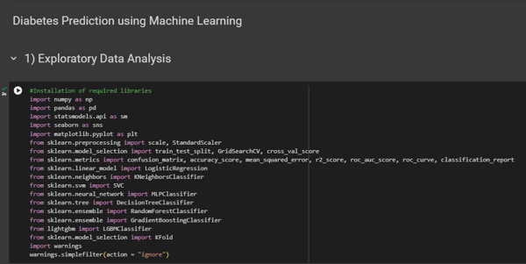
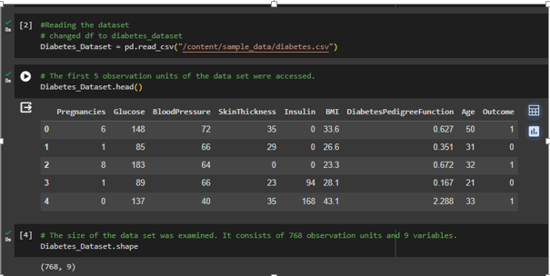
Screen-Shot

Slide 14
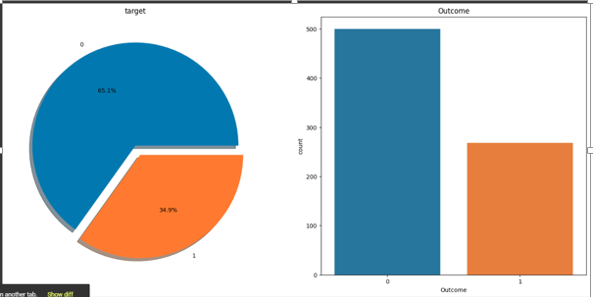
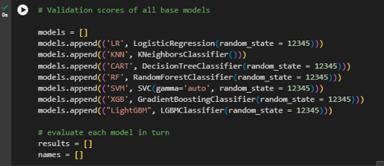
Cont…

Slide 15
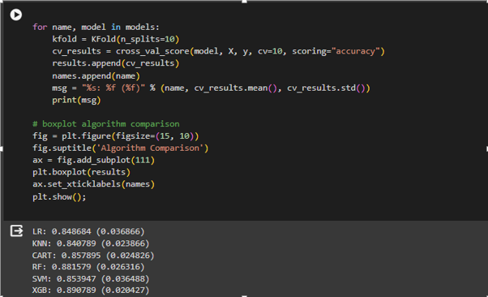
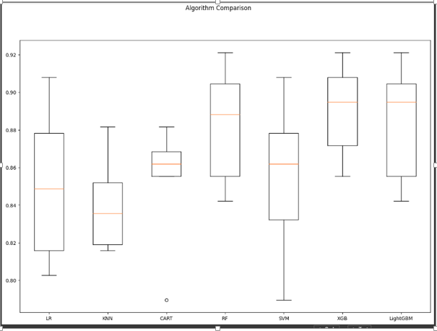
Cont..

Slide 16
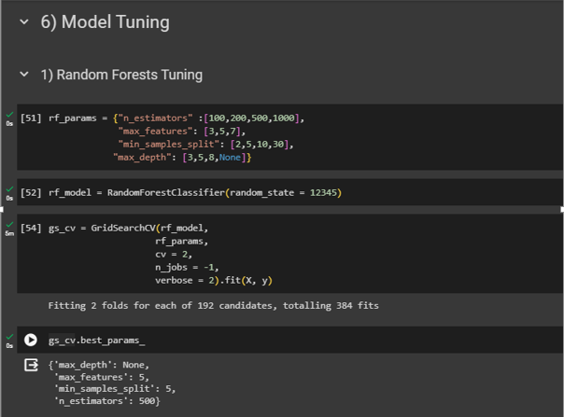
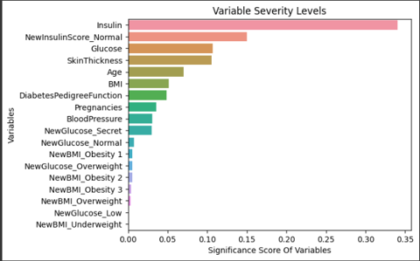
Cont…

Slide 17
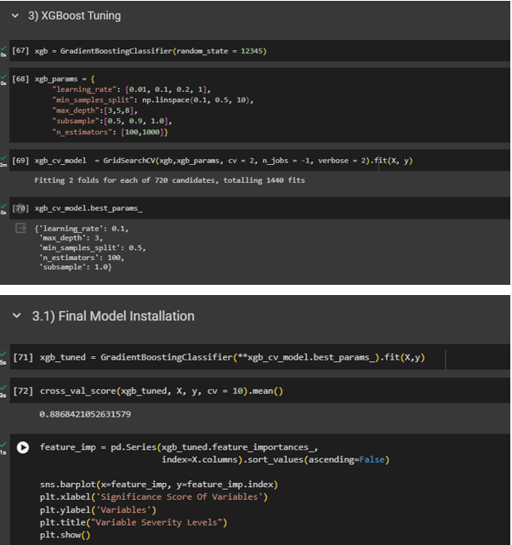
Cont…

Slide 18
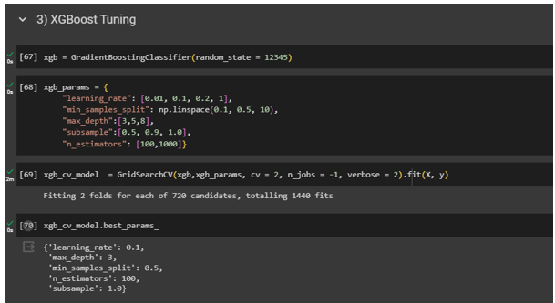
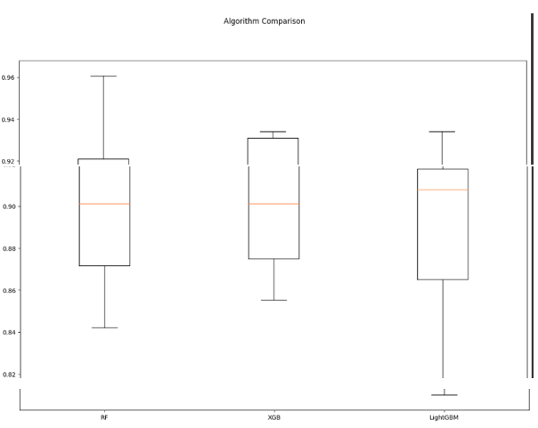
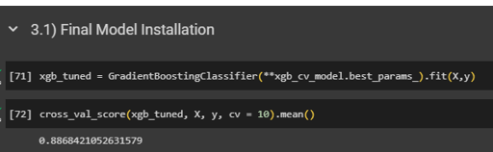
Cont…

Slide 19
Learning Outcomes SCD
Week #3: Introduction to software construction
Problem identification
SCD helps to understand problem and what would be the desired solution
Week #4 : key Construction Decisions
Language selection
Conventions
Technology wave (ML)

Slide 20
Cont…
Week # 9 & 10:
Variables
Week #12:
Collaborative Construction:
Code Reading

Slide 21
Conclusion
In conclusion, this research has delved into the realm of diabetes prediction using machine learning algorithms, aiming to revolutionize early identification and healthcare management.

Slide 22
THANK YOU
.

